Slide 1


Error Detection Techniques Visualization Platform
Comparative Analysis of Data Link Layer Error Detection Algorithms
Course: Computer Networks | Project Type: Algorithm Implementation and Empirical Analysis
Student: Uday Chauhan
Date: 07/02/2026
Notes:
1

Slide 2

Understanding the Data Link Layer's Role
Why Error Detection Matters
During data transmission, electrical noise, electromagnetic interference, and signal attenuation can flip individual bits, corrupting the original message. The Data Link Layer sits between the Physical and Network layers in the OSI model, responsible for node-to-node delivery and ensuring data integrity before forwarding packets.
Key distinction: Error detection identifies corrupted data, while error correction reconstructs the original data. Most protocols use detection with retransmission rather than correction.
Notes:
2

Slide 3

The Challenge of Reliable Data Transmission
Transmission Impairments
Noise, interference, and attenuation during signal propagation can flip bits randomly or in bursts, causing data corruption that affects message integrity.
Detection vs Correction
Detection identifies corrupted data and requests retransmission. Correction reconstructs original data from redundant information—more complex but faster.
Trade-off Balance
Stronger detection requires more redundancy bits and computational overhead. Engineers must balance reliability requirements with performance constraints.
Notes:
3

Slide 4
Error Detection Algorithms: Logic and Complexity
Four classical techniques balance detection strength with computational cost differently:
Algorithm
Method
Time Complexity
Space Complexity
Detection Capability
VRC (Parity)
Single parity bit added
O(n)
O(1)
Single-bit errors only
LRC
Column-wise parity calculation
O(n)
O(block width)
Burst error patterns
CRC
Polynomial division (mod-2)
O(n × k)
O(k)
Very high (Ethernet standard)
Checksum
1's complement sum
O(n)
O(1)
Good for random errors
Key insight: CRC provides strongest detection at higher computational cost, making it ideal for hardware implementations.
Notes:
4

Slide 5

How CRC Works: Polynomial Division
Mathematical Foundation
CRC treats bit sequences as polynomial coefficients. The sender divides data by a generator polynomial using modulo-2 arithmetic (XOR operations). The remainder becomes the checksum.
Properties:
No carry propagation in XOR
Efficient hardware implementation with shift registers
Detects all odd-bit errors and most burst errors
Notes:
5

Slide 6

Step-by-Step Execution: CRC Example
Worked example with data bits 110101 and generator polynomial 1001:
01
02
Append Zeros
Modulo-2 Division
Add (k-1) zeros to data: 110101000 (3 zeros for 4-bit generator)
Perform XOR-based division using generator polynomial 1001
03
04
Calculate Remainder
Form Codeword
Final remainder becomes CRC checksum: 010
Append remainder to original data: 110101010
At receiver: Re-compute CRC. If remainder is zero, data likely uncorrupted. Non-zero remainder indicates transmission error.
Notes:
6

Slide 7




Experimental Methodology
Test Setup
Manual bit-level implementation in Python without external libraries. Simulated transmission channel with controlled bit-flip probability.
Error Injection
Injected single-bit, multi-bit, and burst errors systematically. Tracked detection success across varying error patterns.
Performance Metrics
Measured detection rate, redundancy overhead, computational operations, and execution time for each algorithm.
Notes:
7

Slide 8
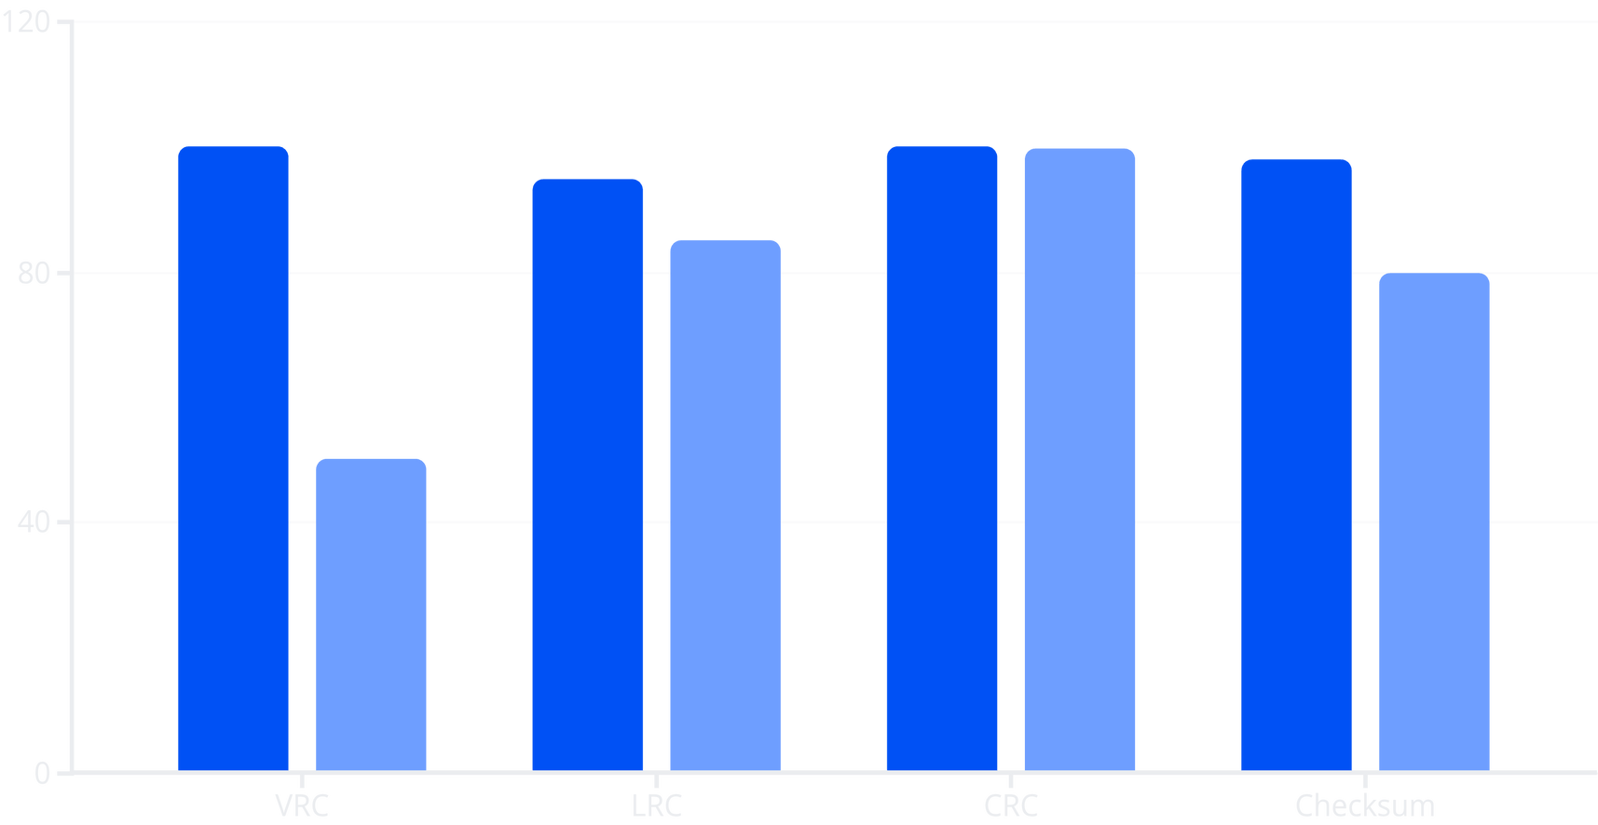
Detection Success Rate Comparison
Single-bit Error Detection
Burst Error Detection
Key finding: CRC achieves ~99.9% burst error detection, making it the gold standard for Ethernet and hardware implementations. VRC detects only odd-bit errors (~50% detection for random bit flips).
Notes:
8

Slide 9



Real-World Applications and Trade-offs
CRC in Ethernet
Checksum in TCP/IP
Parity in ECC Memory
IEEE 802.3 uses CRC-32 for frame validation. High detection capability justifies computational cost in hardware implementations with shift registers.
IP header and TCP segment checksums use 1's complement sum. Software-friendly implementation balances good detection with low overhead.
RAM modules use parity bits (VRC variant) for single-bit error detection. Simple hardware implementation protects against common memory faults.
Notes:
9

Slide 10
Key Learnings and Implementation Insights
Implementation Architecture
Key Takeaways
Manual bit-level implementation from scratch
Backend logic for step-by-step tracking
Frontend visualization for educational clarity
No external libraries used
Algorithm choice depends on channel quality and constraints
CRC preferred in hardware for shift-register efficiency
Checksum ideal for software due to simplicity
Parity still useful despite limitations
Conclusion: Different error detection techniques serve different network requirements. No single algorithm is universally optimal—engineers must balance detection strength, computational overhead, and implementation complexity based on specific use cases.
Notes:
10

Slide 11
Thank You

